Slide 1
Lab 9 Neural Networks
Aya Elzahy

Slide 2
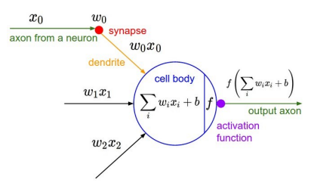

Slide 3
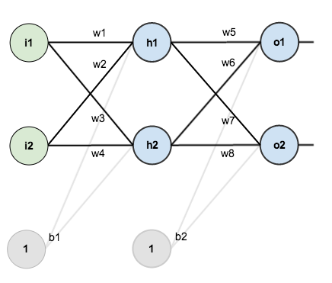
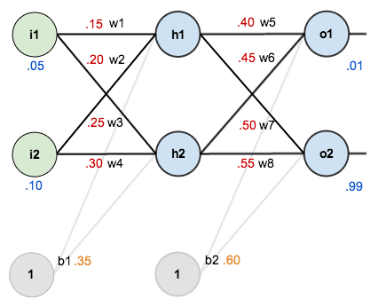

Slide 4
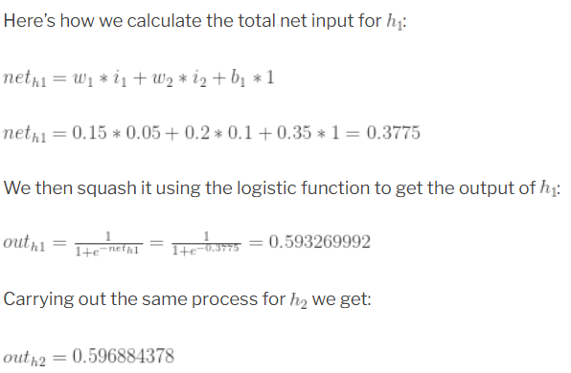
The Forward Pass

Slide 5
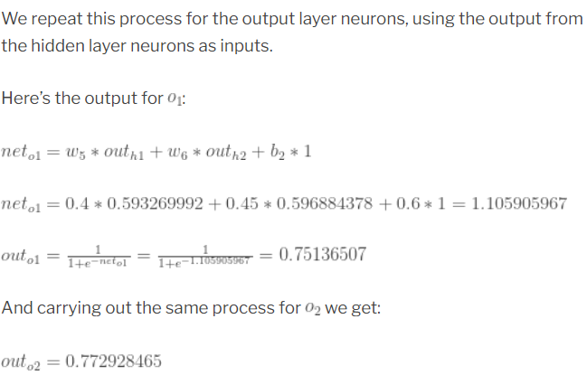
The Forward Pass

Slide 6
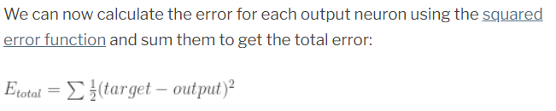
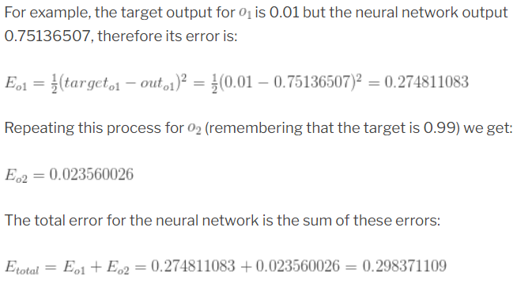
Calculating the Total Error

Slide 7

Backpropagation
Our goal with backpropagation is to update each of the weights in the network so that they cause the actual output to be closer the target output, thereby minimizing the error for each output neuron and the network as a whole.

Slide 8
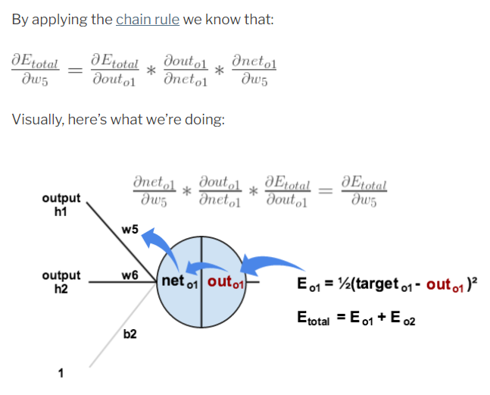
Backpropagation

Slide 9
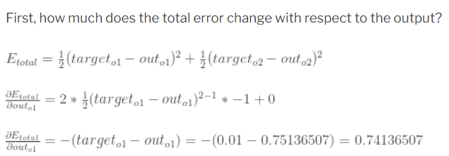
Backpropagation

Slide 10
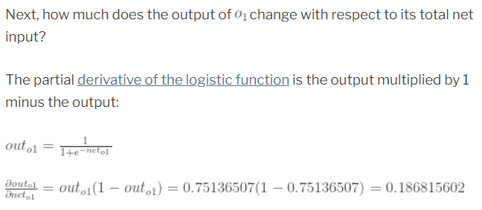
Backpropagation

Slide 11
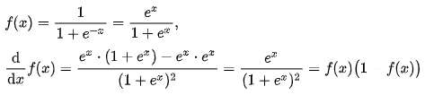
Sigmoid Derivative

Slide 12
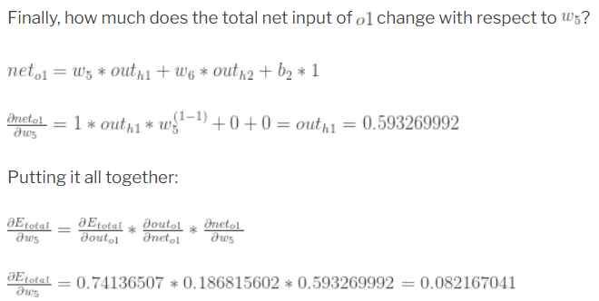

Backpropagation

Slide 13
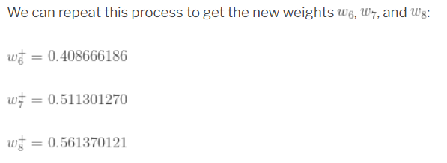
Backpropagation
We perform the actual updates in the neural network after we have the new weights leading into the hidden layer neurons (ie, we use the original weights, not the updated weights, when we continue the backpropagation algorithm).

Slide 14
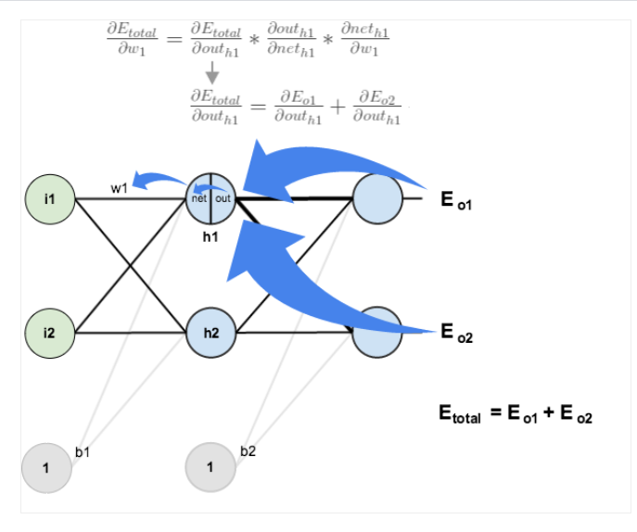
Backpropagation
To update w1

Slide 15
Assignment
Do the forward pass for h2 (You should get a value of 0.5968 for out h2).
Do the backpropagation path for both w1 and w2 (w1 should be 0.14978, w2 should be 0.19956)
Use the tutorial in the references (next slide) for guidance.

Slide 16
References
https://mattmazur.com/2015/03/17/a-step-by-step-backpropagation-example/

